Slide 1
CPE 445-Internet of Things
Dr. Abbas Javed
Assistant Professor
Department of Electrical and Computer Engineering,
COMSATS University Islamabad, Lahore Campus
abbasjaved@cuilahore.edu.pk

Slide 2
Contents
Drivers Behind New Network Architectures: OT networks drive core industrial business operations. They have unique characteristics and constraints that are not easily supported by traditional IT network architectures.
Comparing IoT Architectures: Several architectures have been published for IoT, including those by ETSI and the IoT World Forum. This section discusses and compares these architectures.
A Simplified IoT Architecture: While several IoT architectures exist, a simplified model is presented in this section to lay a foundation for rest of the material discussed in this book.
The Core IoT Functional Stack: The IoT network must be designed to support its unique requirements and constraints. This section provides an overview of the full networking stack, from sensors all the way to the applications layer.
IoT Data Management and Compute Stack: This section introduces data management, including storage and compute resource models for IoT, and involves edge, fog, and cloud computing.

Slide 3
Drivers Behind New Network Architectures
Traditional IT networks are not well suited to the complex requirements of IoT
Key difference between IT and IoT is the data
IT systems are mostly concerned with reliable and continuous support of business applications such as email, web, databases, CRM systems and so on, IoT is all about the data generated by sensors and how that data is used
The essence of IoT architectures thus involves how the data is transported, collected, analyzed, and ultimately acted upon

Slide 4
IoT Architecture Drivers
Challenge | Description | IoT Architectural Change Required
Scale | The massive scale of IoT end- points (sensors) is far beyond that of typical IT networks. | The IPv4 address space has reached exhaustion and is unable to meet IoT’s scalability requirements. Scale can be met only by using IPv6. IT networks continue to use IPv4 through features like Network Address Translation (NAT)
Security | IoT devices, especially those on wireless sensor networks (WSNs), are often physically exposed to the world. | Security is required at every level of the IoT network. Every IoT endpoint node on the network must be part of the overall security strategy and must support device-level authentication and link encryption. It must also be easy to deploy with some type of a zero-touch deployment model
Devices and networks constrained by power, CPU, memory, and link Speed | Due to the massive scale and longer distances, the networks are often constrained, lossy, and capable of supporting only minimal data rates (tens of bps to hundreds of Kbps). | New last-mile wireless technologies are needed to support constrained IoT devices over long distances. The network is also constrained, meaning modifications need to be made to traditional network-layer transport mechanisms.

Slide 5
IoT Architecture Drivers
Challenge | Description | IoT Architectural Change Required
The massive volume of data generated | The sensors generate a massive amount of data on a daily basis, causing network bottlenecks and slow analytics in the cloud | Data analytics capabilities need to be distributed throughout the IoT network, from the edge to the cloud. In traditional IT networks, analytics and applications typically run only in the cloud.
Support for legacy devices | An IoT network often comprises a collection of modern, IP capable endpoints as well as legacy, non-IP devices that rely on serial or proprietary protocols. | Digital transformation is a long process that may take many years, and IoT networks need to support protocol translation and/or tunneling mechanisms to support legacy protocols over standards based protocols, such as Ethernet and IP.
The need for data to be analyzed in real time | Whereas traditional IT networks perform scheduled batch processing of data, IoT data needs to be analyzed and responded to in real-time. | Analytics software needs to be positioned closer to the edge and should support real-time streaming analytics. Traditional IT analytics software (such as relational databases or even Hadoop), are better suited to batch-level analytics that occur after the fact.

Slide 6
Comparing IoT Architectures
The oneM2M IoT Standardized Architecture
In an effort to standardize the rapidly growing field of machine-to-machine (M2M) communications, the European Telecommunications Standards Institute (ETSI) created the M2M Technical Committee in 2008.
The goal of this committee was to create a common architecture that would help accelerate the adoption of M2M applications and devices. Over time, the scope has expanded to include the Internet of Things.
in 2012 ETSI and 13 other founding members launched oneM2M as a global initiative designed to promote efficient M2M communication systems and IoT

Slide 7
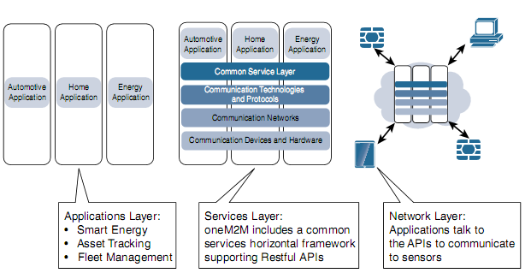
oneM2M IoT Architecture
The Main Elements of the oneM2M IoT Architecture

Slide 8
oneM2M IoT Architecture
Network Layer supports all communication and networking tasks.
The common service provides common services for the IoT system, such as security, device management, and data storage. The common services layer communicates with the other layers through a set of standard interfaces and protocols.
Application Layer implements an M2M application service logic. Examples of such application entities are smart metering monitoring in a smart grid or a patient monitoring system using an IoT infrastructure. The NS provides services from the underlying network to the CS entity. Examples of NS services include device management, location services and device triggering.

Slide 9
IoT World Forum (IoTWF) Standardized Architecture
In 2014 the IoTWF architectural committee (led by Cisco, IBM, Rockwell Automation, and others) published a seven-layer IoT architectural reference model
IoT World Forum offers a clean, simplified perspective on IoT and includes edge computing, data storage, and access
A succinct way of visualizing IoT from a technical perspective
The IoT Reference Model defines a set of levels with control flowing from the center (this could be either a cloud service or a dedicated data center), to the edge, which includes sensors, devices, machines, and other types of intelligent end nodes

Slide 10
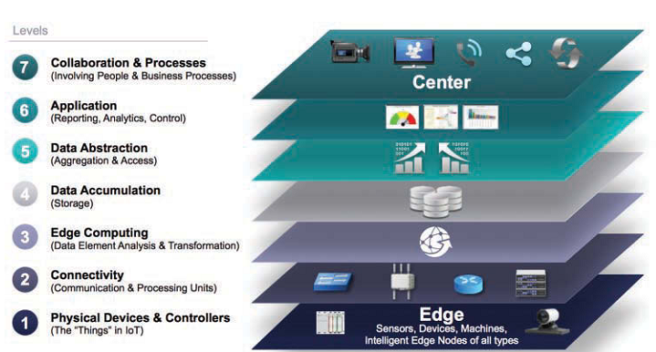
IoT World Forum (IoTWF) Standardized Architecture
IoT Reference Model Published by the IoT World Forum

Slide 11
Advantages of IoT World Forum (IoTWF) Standardized Architecture
Decompose the IoT problem into smaller parts
Identify different technologies at each layer and how they relate to one another
Define a system in which different parts can be provided by different vendors
Have a process of defining interfaces that leads to interoperability
Define a tiered security model that is enforced at the transition points between levels

Slide 12
IoT World Forum (IoTWF) Standardized Architecture
Layer 1: Physical Devices and Controllers Layer
The first layer of the IoT Reference Model is the physical devices and controllers layer. This layer is home to the “things” in the Internet of Things, including the various endpoint devices and sensors that send and receive information
Layer 2: Connectivity Layer
In the second layer of the IoT Reference Model, the focus is on connectivity. The most
important function of this IoT layer is the reliable and timely transmission of data. More specifically, this includes transmissions between Layer 1 devices and the network
and between the network and information processing that occurs at Layer 3 (the edge
computing layer).

Slide 13
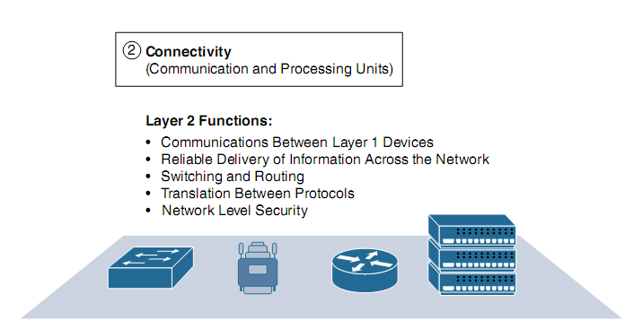
IoT Reference Model Connectivity Layer Functions

Slide 14
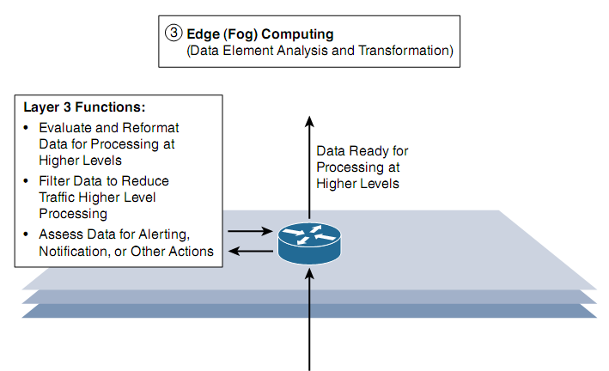
Layer 3: Edge Computing Layer
Edge computing is the role of Layer 3. Edge computing is often referred to as the “fog” layer. At this layer, the emphasis is on data reduction and converting network data flows into information that is ready for storage and processing by higher layers. One of the basic principles of this reference model is that information processing is initiated as early and as close to the edge of the network as possible.
IoT Reference Model Layer 3 Functions

Slide 15
Summary of Layers 4–7 of the IoTWF Reference Model
IoT Reference Model Layer | Functions
Layer 4: Data accumulation layer | Captures data and stores it so it is usable by applications when necessary. Converts event-based data to query-based processing.
Layer 5: Data abstraction layer | Reconciles multiple data formats and ensures consistent semantics from various sources. Confirms that the data set is complete and consolidates data into one place or multiple data stores using virtualization.
Layer 6: Applications layer | Interprets data using software applications. Applications may monitor, control, and provide reports based on the analysis of the data.
Layer 7: Collaboration and processes layer | Consumes and shares the application information. Collaborating on and communicating IoT information often requires multiple steps, and it is what makes IoT useful. This layer can change business processes and delivers the benefits of IoT

Slide 16
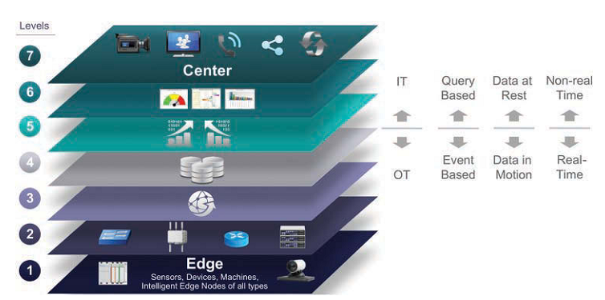
IoT Reference Model Separation of IT and OT

Slide 17
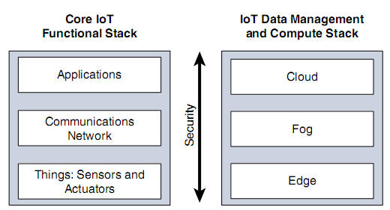
Simplified IoT Architecture

Slide 18
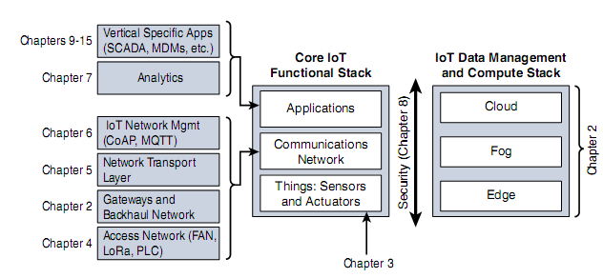
Expanded View of the Simplified IoT Architecture

Slide 19
The Core IoT Functional Stack
“Things” layer: At this layer, the physical devices need to fit the constraints of the environment in which they are deployed while still being able to provide the information needed.
Communications network layer: When smart objects are not self-contained, they need to communicate with an external system. In many cases, this communication uses a wireless technology. This layer has four sublayers:
Access network sublayer: The last mile of the IoT network is the access network. This is typically made up of wireless technologies such as 802.11ah, 802.15.4g, and LoRa. The sensors connected to the access network may also be wired.

Slide 20
Gateways and backhaul network sublayer: A common communication system organizes multiple smart objects in a given area around a common gateway. The gateway communicates directly with the smart objects. The role of the gateway is to forward the collected information through a longer-range medium (called the backhaul) to a headend central station where the information is processed. This information exchange is a Layer 7 (application) function, which is the reason this object is called a gateway. On IP networks, this gateway also forwards packets from one IP network to another, and it therefore acts as a router.
Network transport sublayer: For communication to be successful, network and transport layer protocols such as IP and UDP must be implemented to support the variety of devices to connect and media to use.
IoT network management sublayer: Additional protocols must be in place to allow the headend applications to exchange data with the sensors. Examples include CoAP and MQTT.
Application and analytics layer: At the upper layer, an application needs to process the collected data, not only to control the smart objects when necessary, but to make intelligent decision based on the information collected and, in turn, instruct the “things” or other systems to adapt to the analyzed conditions and change their behaviors or parameters.

Slide 21
Layer 1: Things: Sensors and Actuators Layer
Battery-powered or power-connected
Mobile or static
Low or high reporting frequency
Simple or rich data
Report range
Object density per cell

Slide 22
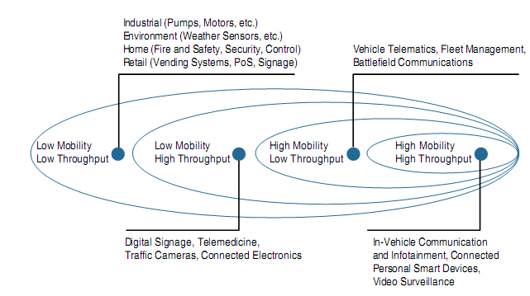
Layer 2: Communications Network Layer
Example of Sensor Applications Based on Mobility and Throughput

Slide 23
Layer 2: Communications Network Layer
PAN (personal area network): Scale of a few meters. This is the personal space around a person. A common wireless technology for this scale is Bluetooth.
HAN (home area network): Scale of a few tens of meters. At this scale, common wireless technologies for IoT include ZigBee and Bluetooth Low Energy (BLE).
NAN (neighborhood area network): Scale of a few hundreds of meters. The term NAN is often used to refer to a group of house units from which data is collected.
FAN (field area network): Scale of several tens of meters to several hundred meters. FAN typically refers to an outdoor area larger than a single group of house units. The FAN is often seen as “open space” (and therefore not secured and not controlled). A FAN is sometimes viewed as a group of NANs, but some verticals see the FAN as a group of HANs or a group of smaller outdoor cells. As you can see, FAN and NAN may sometimes be used interchangeably. In most cases, the vertical context is clear enough to determine the grouping hierarchy
LAN (local area network): Scale of up to 100 m. This term is very common in networking, and it is therefore also commonly used in the IoT space when standard networking technologies (such as Ethernet or IEEE 802.11) are used. Other networking classifications, such as MAN (metropolitan area network, with a range of up to a few kilometers) and WAN (wide area network, with a range of more than a few kilometers), are also commonly used.

Slide 24
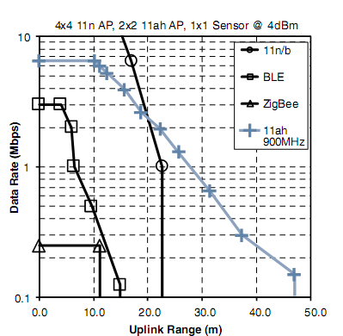
Range Versus Throughput for Four WHAN to WLAN Technologies

Slide 25
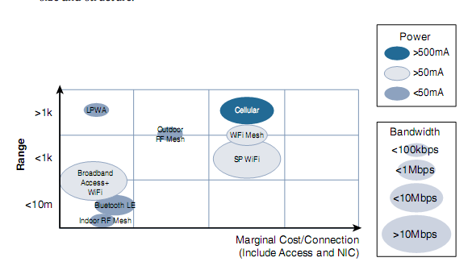
Comparison Between Common Last-Mile Technologies in Terms of Range Versus Cost, Power, and Bandwidth

Slide 26
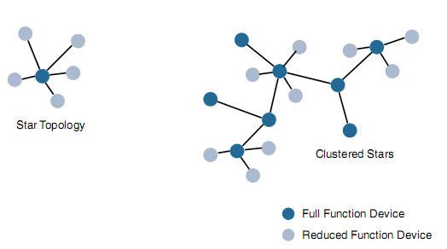
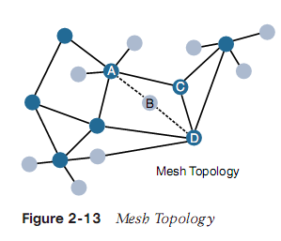

Slide 27
Gateways and Backhaul Sublayer:
data directly received from the sensor through an access technology needs to be forwarded to another medium (the backhaul) and transported to the central station. The gateway is in charge of this inter-medium communication
Gateway can be static or mobile (e.g. DSRC)
throughput decreases as node-to-node distance increases, and it also decreases as the number of hops increases
WiMAX (802.16) is an example of a longer-range technology

Slide 28
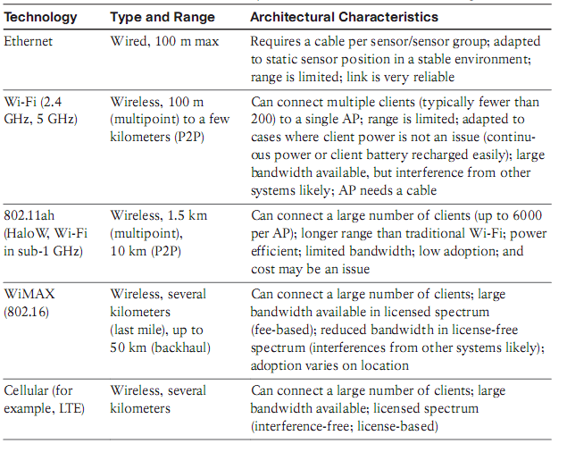
Architectural Considerations for WiMAX and Cellular Technologies

Slide 29
Layer 3: Applications and Analytics Layer
Analytics Versus Control Applications
Analytics application: data collection, processing and display
Control application: e.g. pressure control
Data Versus Network Analytics
Data analytics- e.g. dashboard
Network analytics- loss or degradation in connectivity
Data Analytics Versus Business Benefits
Cisco Jasper-cloud-based platform for IoT management and monetization
Smart Services
The ability to use IoT to improve operations is often termed “smart services

Slide 30
IoT Data Management and Compute Stack
Minimizing latency: Milliseconds matter for many types of industrial systems, such as when you are trying to prevent manufacturing line shutdowns or restore electrical service. Analyzing data close to the device that collected the data can make a difference between averting disaster and a cascading system failure
Conserving network bandwidth: Offshore oil rigs generate 500 GB of data weekly. Commercial jets generate 10 TB for every 30 minutes of flight. It is not practical to transport vast amounts of data from thousands or hundreds of thousands of edge devices to the cloud. Nor is it necessary because many critical analyses do not require cloud-scale processing and storage.
Increasing local efficiency: Collecting and securing data across a wide geographic area with different environmental conditions may not be useful. The environmental conditions in one area will trigger a local response independent from the conditions of another site hundreds of miles away. Analyzing both areas in the same cloud system may not be necessary for immediate efficiency.
*a moderately sized smart meter network of 1 million meters will generate close to 1 billion data points each day (including meter reads and other instrumentation data), resulting in 1 TB of data.

Slide 31
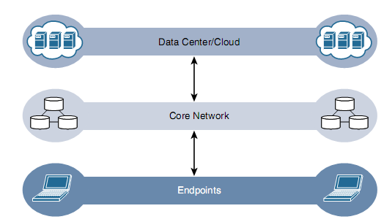
The Traditional IT Cloud Computing Model

Slide 32
IoT systems function differently. Several data-related problems need to be addressed:
Bandwidth in last-mile IoT networks is very limited. When dealing with thousands/millions of devices, available bandwidth may be on order of tens of Kbps per device or even less.
Latency can be very high. Instead of dealing with latency in the milliseconds range, large IoT networks often introduce latency of hundreds to thousands of milliseconds.
Network backhaul from the gateway can be unreliable and often depends on 4G/LTE or even satellite links. Backhaul links can also be expensive if a per-byte data usage model is necessary.
The volume of data transmitted over the backhaul can be high, and much of the data may not really be that interesting (such as simple polling messages).
Big data is getting bigger. The concept of storing and analyzing all sensor data in the cloud is impractical. The sheer volume of data generated makes real-time analysis and response to the data almost impossible.

Slide 33
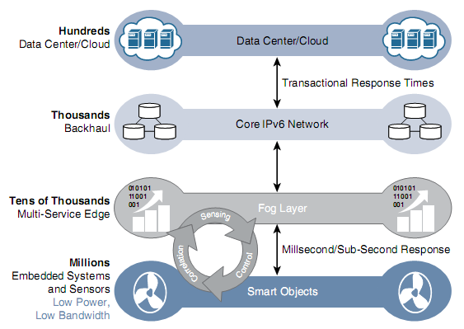
Fog Computing
* The concept of fog was first developed by Flavio Bonomi and Rodolfo Milito of Cisco Systems
* the term “fog” was
actually coined by Ginny Nichols, Rodolfo’s wife.
The IoT Data Management and Compute Stack with Fog Computing

Slide 34
Fog Computing- Examples
Fog node analyzing information from the sensors on derrick
Fog node for monitoring tire pressures of trucks
Door locking
Applying brakes on train
Zooming a video camera
Creating a bar chart
Sending an alert to technician to make a preventive repair

Slide 35
Characteristic of Fog Computing
Contextual location awareness and low latency: The fog node sits as close to the IoT endpoint as possible to deliver distributed computing
Geographic distribution: In sharp contrast to the more centralized cloud, the services and applications targeted by the fog nodes demand widely distributed deployments
Deployment near IoT endpoints: Fog nodes are typically deployed in the presence of a large number of IoT endpoints. For example, typical metering deployments often see 3000 to 4000 nodes per gateway router, which also functions as the fog computing node
Wireless communication between the fog and the IoT endpoint: Although it is possible to connect wired nodes, the advantages of fog are greatest when dealing with a large number of endpoints, and wireless access is the easiest way to achieve such scale
Use for real-time interactions: Important fog applications involve real-time interactions rather than batch processing. Preprocessing of data in the fog nodes allows upper-layer applications to perform batch processing on a subset of the data

Slide 36
Edge Computing
Edge computing is also sometimes called “mist” computing. If clouds exist in the sky, and fog sits near the ground, then mist is what actually sits on the ground. Thus, the concept of mist is to extend fog to the furthest point possible, right into the IoT endpoint device itself.
Edge compute–capable meters are able to communicate with each other to share information on small subsets of the electrical distribution grid to monitor localized power quality and consumption, and they can inform a fog node of events that may pertain to only tiny sections of the grid. Models such as these help ensure the highest quality of power delivery to customers.

Slide 37
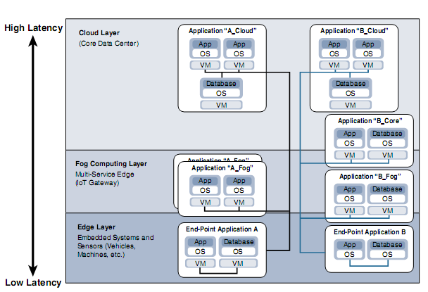
The Hierarchy of Edge, Fog, and Cloud
Distributed Compute and Data Management Across an IoT System

Slide 38
Optimal place for data analysis
The most time-sensitive data is analyzed on the edge or fog node closest to the things generating the data.
Data that can wait seconds or minutes for action is passed along to an aggregation node for analysis and action.
Data that is less time sensitive is sent to the cloud for historical analysis, big data analytics, and long-term storage. For example, each of thousands or hundreds of thousands of fog nodes might send periodic summaries of data to the cloud for historical analysis and storage.

Slide 39
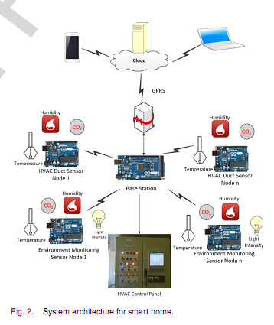
Case Study: Smart Random Neural Network Controller for HVAC Using Cloud Computing Technology

Slide 40
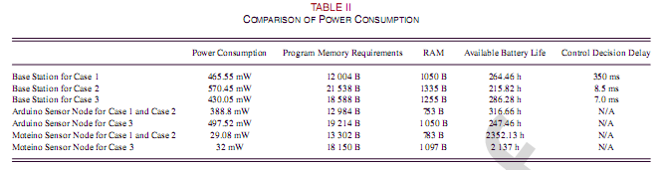
Case 1: Processing in Cloud Case 2: Processing in Fog Case 3: Processing in Edge

Slide 41
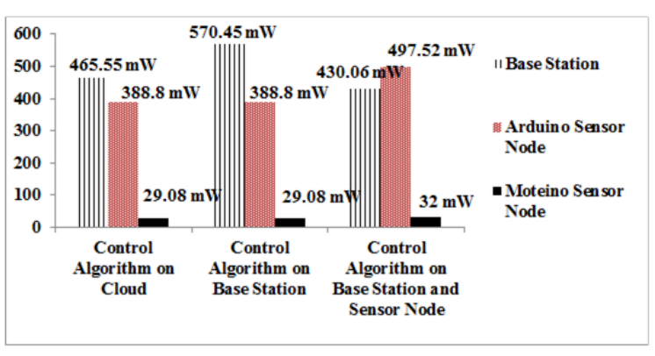
Comparison of power consumption

